Slide 1
AI TOOL for early stage dementia detection
CSE7302- Internship / University Project Reviews
Review-1
Batch Number : CSE-176
Under the Supervision of,
Mr. Sri Ram Katta
Associate Professor
School of Computer Science and Engineering
Presidency University
Roll Number | Student Name
20221CSE0268 | PIRUTHVIRAJ S
20221CSE0270 | RAFAEL V
20221CSE0260 | REVANTH ADITHYA V
Name of the Program : Computer Science and Engineering
Name of the HoD : Dr.
Name of the Program Project Coordinator : Dr. Jayavadivel Ravi
Name of the School Project Coordinators : Dr. Sampath A K , Dr. Geetha A

Slide 2
Problem Statement Number - SIH25226
Organization : Ministry of Health and Family Welfare
Category (Hardware / Software / Both) : Software
Problem Description : Early-stage dementia often remains undiagnosed due to subtle symptoms and limited access to early screening tools. This problem focuses on developing an AI-based software solution to analyse cognitive, behavioural, and speech patterns for early risk detection. The system aims to support timely medical consultation and preventive intervention.

Slide 3
Content
Problem Statement
Objectives
Background and Related work for title Selection
Analysis of Problem Statement
Innovation or Novel Contributions
Git-hub Link
Timeline of the Project
References

Slide 4
Problem Statement
Dementia is a progressive neurological condition that often remains undetected in its early stages due to subtle symptoms and lack of easily accessible screening tools, leading to delayed diagnosis and reduced effectiveness of treatment and care.
Early-stage dementia symptoms such as mild memory loss, speech irregularities, and behavioural changes are difficult to identify through traditional clinical methods without specialised tests, which are often costly and time-consuming.
With the increasing elderly population, there is a growing need for scalable and technology-driven solutions that can assist in early screening and monitoring of cognitive health in a non-invasive manner.
Artificial Intelligence and Machine Learning techniques have the potential to analyse cognitive performance, speech patterns, and behavioural indicators to identify early warning signs that may not be easily noticeable to humans.
There is a need to develop an AI-based software solution that can provide early risk assessment for dementia, support timely medical consultation, and promote preventive healthcare without replacing professional medical diagnosis.

Slide 5
Objectives
Enable early identification of dementia risk.
Develop an AI-based cognitive screening system.
Analyse speech, behavioural, and cognitive patterns.
Provide early risk assessment to support medical consultation.
Improve accessibility to preliminary dementia screening.
Support preventive and proactive healthcare practices.
Reduce delay in clinical evaluation and intervention.
Ensure non-invasive and user-friendly assessment.
Promote scalable and cost-effective healthcare solutions.

Slide 6
Analysis of Problem Statement
Technology Stack Components:
DataCollection : Publicly available medical datasets, cognitive assessment datasets, and speech samples.
Machine Learning Models : Supervised learning models for classification and risk prediction.
AI Frameworks : Python-based frameworks such as TensorFlow, PyTorch, and Scikit-learn.
Speech Analysis : Speech-to-text processing, voice feature extraction, and pattern analysis tools.
Cognitive Testing : Digitized memory, attention, and reaction-time assessment modules.
Data Processing : Data cleaning, normalization, and feature extraction techniques.
Backend Development : Flask / FastAPI for model integration and API services.
Frontend Interface : Web or mobile-based user interface for assessments and results display.
Deployment : Cloud platforms such as Google Cloud, AWS, or Azure.

Slide 7
Analysis of Problem Statement (contd...)
Software and Hardware Requirements:
Software Platform : AI-based web or mobile application for dementia risk screening.
AI Processing : Machine learning model execution on cloud or local servers.
Data Storage : Secure cloud storage for user inputs and analysis results.
User Access Control : Secure login system with role-based access for users and professionals.
Security & Privacy : Encryption of sensitive user data and compliance with data protection standards.
Device Compatibility : Works on standard smartphones, tablets, and computers.
Internet Requirement : Stable internet connection for cloud-based analysis and updates.
Optional Hardware : EEG or voice recording devices (optional for advanced analysis).

Slide 8
Analysis of Problem Statement (contd...)
Market: Increasing elderly population and growing awareness about cognitive health have created a strong demand for early and accessible dementia screening tools across healthcare and community settings.
Problem : Early-stage dementia often remains undiagnosed due to subtle symptoms, lack of affordable screening tools, and dependence on costly clinical assessments.
Solution : An AI-based software solution that analyses cognitive, behavioural, and speech patterns to provide early risk assessment and support timely medical consultation.
Feasibility : The solution is technically feasible using existing AI frameworks and public datasets, cost-effective to implement, and manageable by a small development team.
Impact : Enables early identification of dementia risk, supports preventive healthcare, reduces diagnostic delays, and improves quality of life through timely intervention.

Slide 9
Github Link
The Github link provided should have public access permission.
Github Link :
https://github.com/dexty8147/AI-TOOL-FOR-EARLY-STAGE-DIMENTIA-DETECTION.git

Slide 10
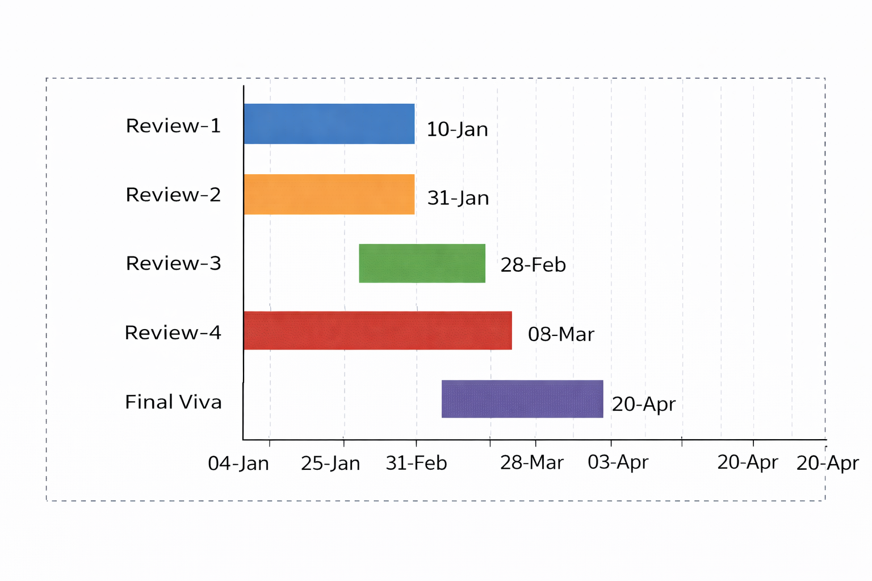
Timeline of the Project (Gantt Chart)
PHASE | ACTIVITY | START DATE | END DATE
Review-1 | Problem statement and objectives | 10-01-2026 | 16-01-2026
Review-2 | Literature review and model design | 31-01-2026 | 06-02-2026
Review-3 | Development and progress | 28-02-2026 | 06-03-2026
Review-4 | Testing and final progress | 03-04-2026 | 09-04-2026
Final Viva | Submission and viva | 20-04-2026 | 26-04-2026

Slide 11
References (IEEE Paper format)
[1]. World Health Organization (WHO), “Dementia – Key Facts,” WHO, 2023. https://www.who.int/news-room/fact-sheets/detail/dementia
[2]. Alzheimer’s Association, “What Is Dementia?,” Alzheimer’s Association, 2024. https://www.alz.org/alzheimers-dementia/what-is-dementia
[3]. M. Gauthier et al., “Artificial Intelligence in Early Detection of Dementia,” Journal of Medical Systems, vol. 45, no. 3, 2021.
[4]. A. Fraser et al., “Detecting Cognitive Decline Using Speech and Language Analysis,” IEEE Journal of Biomedical and Health Informatics, 2020.
[5]. Scikit-learn Developers, “Machine Learning in Python,” Scikit-learn Documentation. https://scikit-learn.org
[6]. TensorFlow, “An End-to-End Open Source Machine Learning Platform,” TensorFlow.org. https://www.tensorflow.org
[7]. Librosa Developers, “Librosa: Audio and Music Signal Analysis in Python,” Librosa Documentation. https://librosa.org
[8]. Google Research, “Speech Recognition and Cognitive Analysis Using AI,” Google AI Blog. https://ai.googleblog.com
[9]. ChatGPT, OpenAI, “AI-assisted Research and Content Generation Tool,” OpenAI. https://www.openai.com

Slide 12


